Slide 1



Question
How many of you think Google is listening to us ?

Slide 2
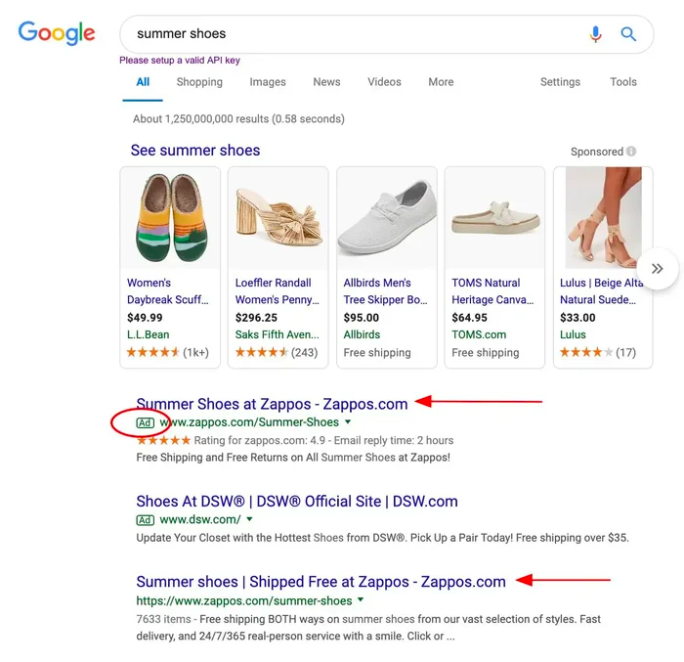
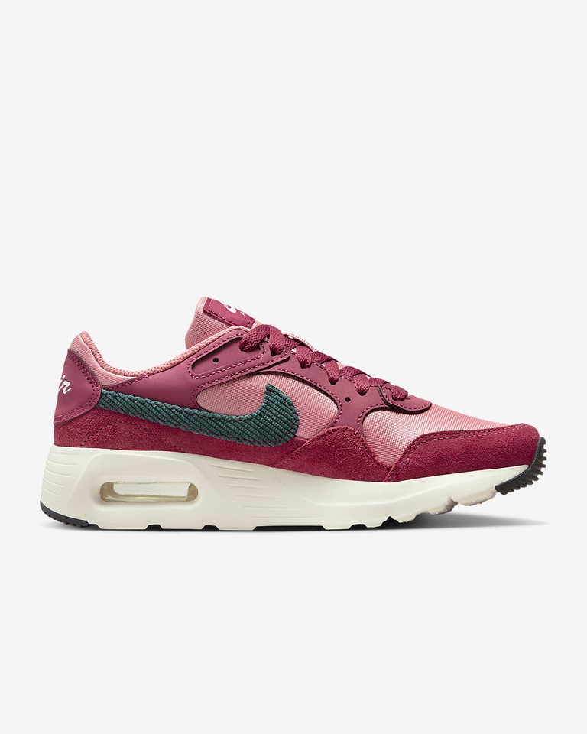




Slide 3
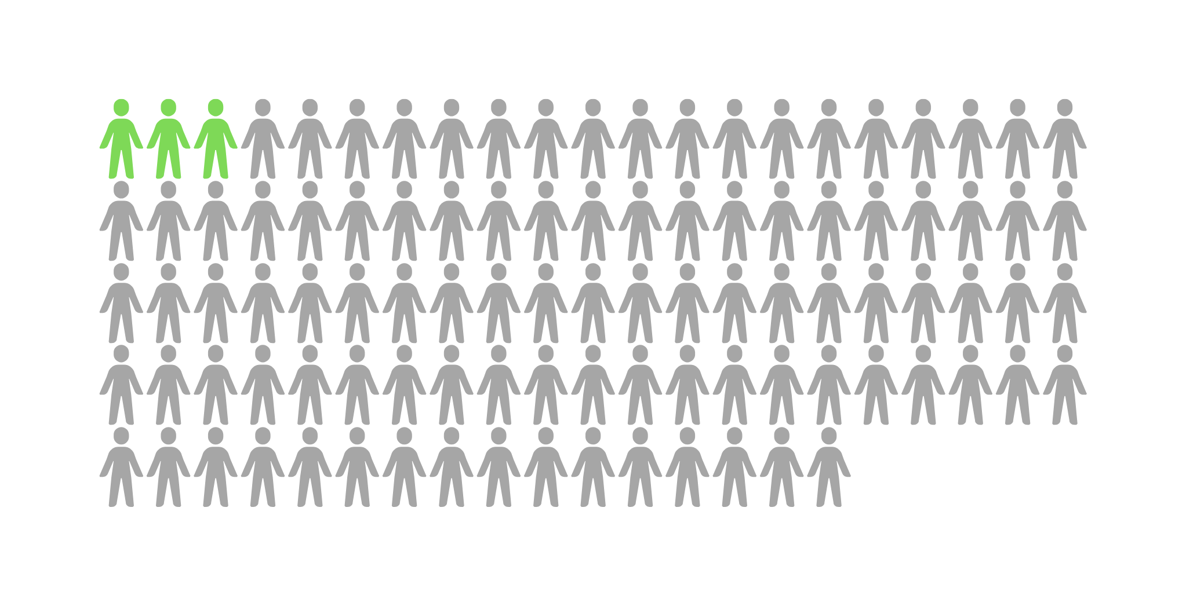
We are targeting Yes! , but are we better targeting ??

Slide 4




Slide 5





Our solution is
Features targeting
=

Slide 6

Treating everyone same

Slide 7


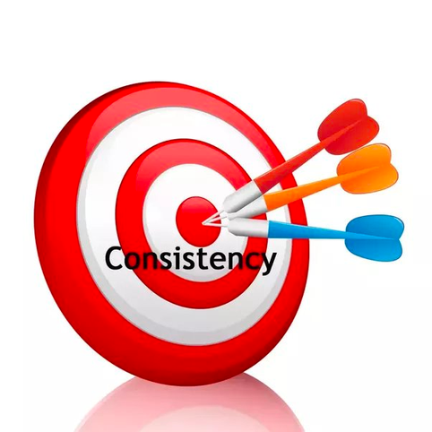
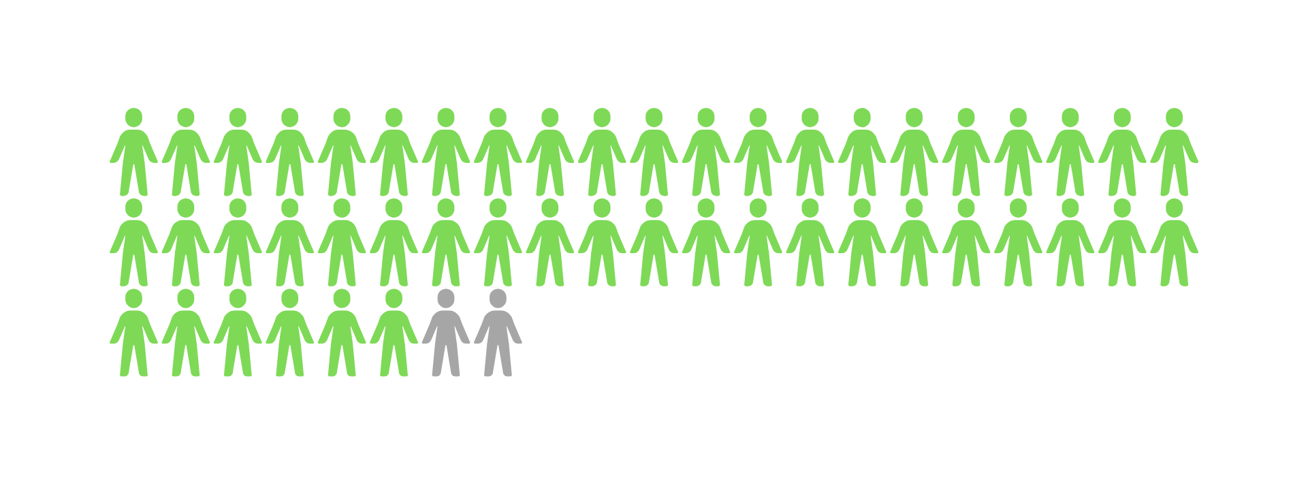
People with desired features

Slide 8



UMBC
20
23
Data 603
Analysis and Prediction of advertising and Marketing Data
Team Members
Lohitha Pulijala UI69297
Nikhitha Guntaka NGUTAK1

Slide 9

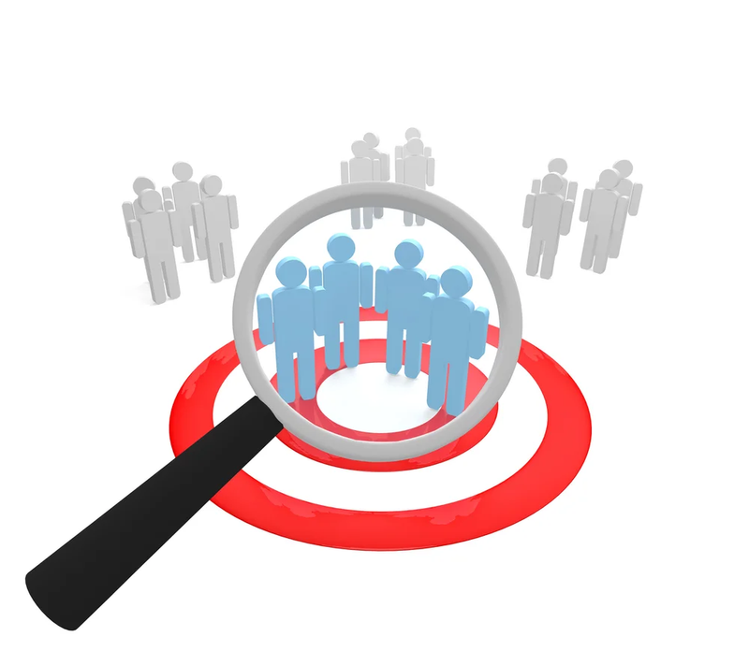
Business Proposal
A data-driven marketing strategist at a forward-thinking online advertising agency, is confronted with a common yet complex puzzle
The digital landscape is crowded, and despite having eye-catching ads, their campaigns' effectiveness is hit-or-miss. They're reaching people, but not necessarily influencing them.

Slide 10
Our breakthrough Solution:
It’s not a peice of cake!!
We introduce an advanced Machine Learning model, meticulously crafted to redefine the efficiency of online advertising campaigns.
Our model is a game-changer - it goes a step beyond mere exposure, identifying individuals as target class who are not just likely to see the ad but are inclined to act because of it.

Slide 11


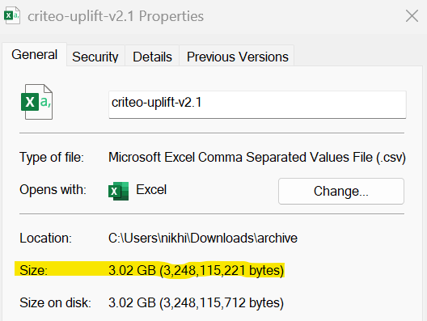
Overview
DATA SET
Size: 3.02 GB
No. of Samples: 13979592 Entries
No. of features: 12
Reference:
https://www.kaggle.com/datasets/arashnic/uplift-modeling

Slide 12
TODAYS
Project Scope
Data Acquisition and Preprocessing
Explore Data Analysis
Model Building & Evaluation
Resampling & Uplifting Model

Slide 13
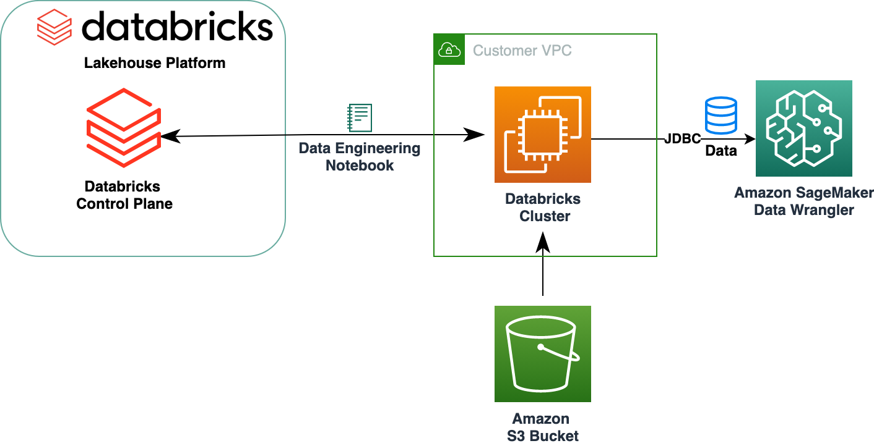
A Seamless Approach to Fetching Data from Amazon S3 into Databricks

Slide 14
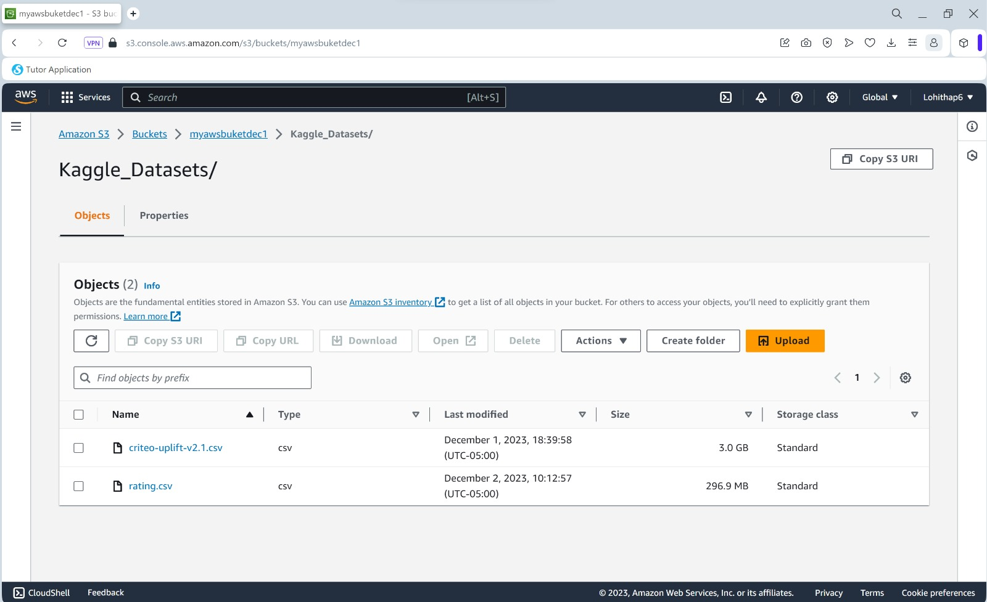

Slide 15


f0, f1, f2, f3, f4, f5, f6, f7, f8, f9, f10, f11: feature values (dense, float)
treatment: Indicates whether a user was part of the treatment group (1) or the control group (0), reflecting their exposure to the marketing campaign.
conversion: Signifies whether a user completed a desired action, such as making a purchase (binary indicator), serving as a key metric for the success of the campaign.
visit: Represents whether a user visited the website or platform (binary indicator), signaling direct engagement with the brand or product
exposure: Denotes whether the user was effectively exposed to the treatment, capturing the actual impact of the marketing campaign on the user.(treatment effect)
Description of the features

Slide 16
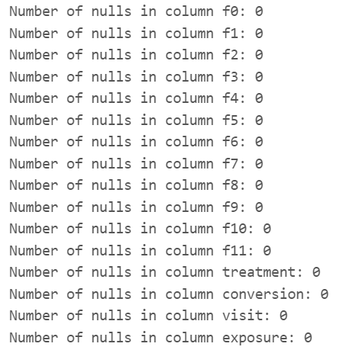
Exploratory Data Analysis
There are 12 features and 2 variables for treatment and 2 variables for target
There are no null values in the 13M users

Slide 17
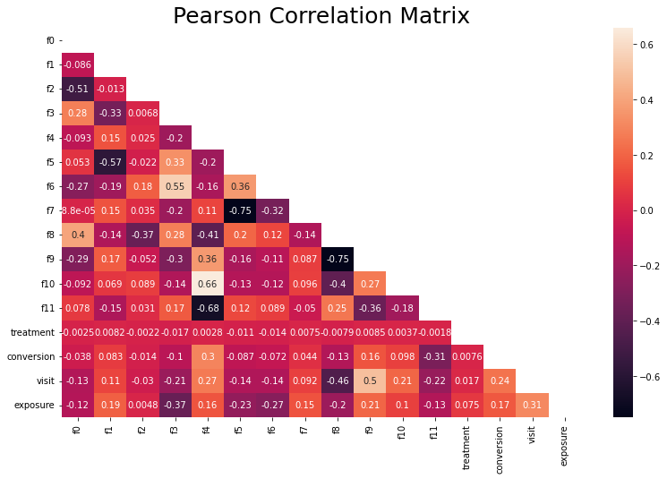
Correlation Matrix
Some of the features have a strong correlation between them
There were no features with an absolute score correlation above 0.31 for conversion
There were two features with an absolute score correlation above 0.31 for visit

Slide 18


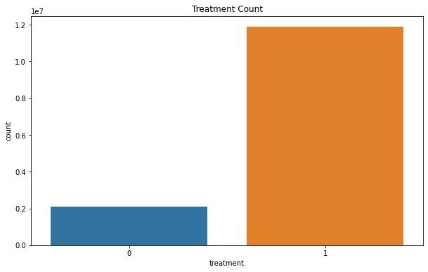
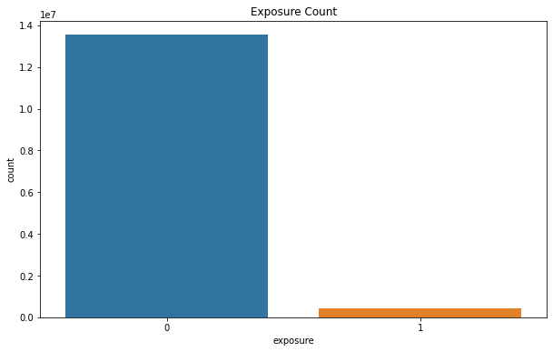
Imbalance Between features
Calculation of proportion for each category
Treatment Vs Count
Exposure Vs Count
The percentages of treatment are: 85% with treatment and 15% without treatment
The percentages of exposure are: 3% with exposure and 97% without exposure

Slide 19
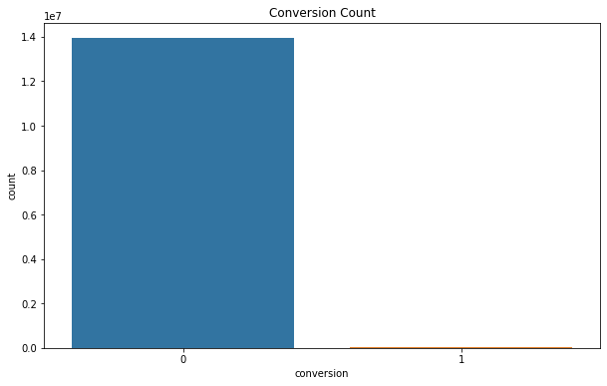
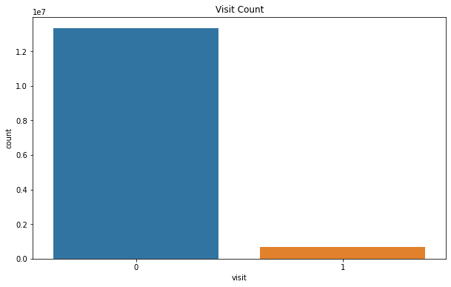
Imbalance between features
Calculation of proportion for each category
Conversion Vs Count
Visits Vs Count
The percentages of conversion are: 0.2% with conversion and 99% without conversion
The percentages of visits are: 5% with conversion and 95% without conversion

Slide 20
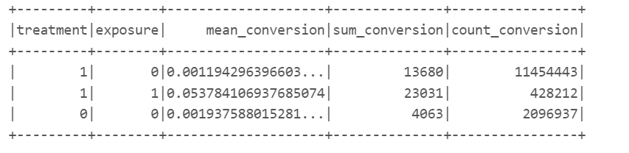
Conversion for Treatment and Exposure
It seems that it is only worth giving the full exposure instead of giving it partially.

Slide 21
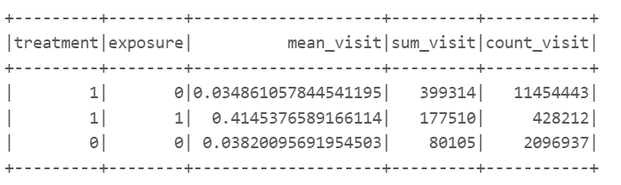
Conversion for Visits and Exposure
It can be seen similar behavior as in conversion, it seems that only giving the full treatment and avoiding sending the partial treatment yield better results.

Slide 22
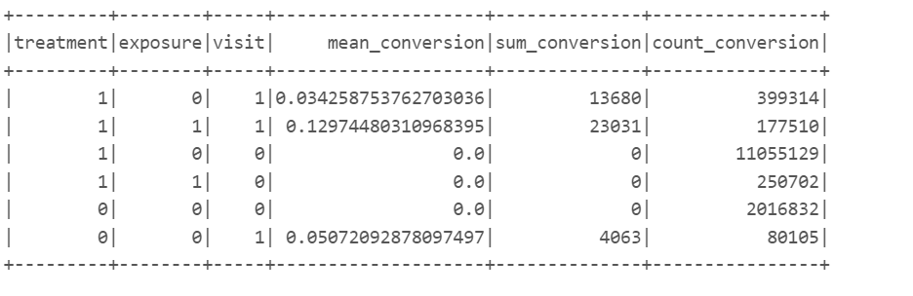
Impact of Treatment, Visit, Exposure on Conversion
In brief, there is a negative impact of the partial treatment on the results, either on visits and conversions.

Slide 23

Model Approach
Model Names | Accuracy
Logistic Regression | 0.9476651556524834
Random Forest | 0.9232986185517099
Gradient-Boosted Trees | 0.9490420267105043
FOCAL POINT OF MODELLING
Conversion as the Key Metric: - the ultimate indicator of a user making a purchase.
Targeting Conversion with Precision score

Slide 24
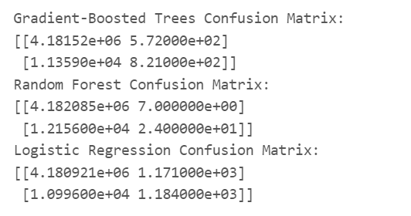
Confusion Matrix
True Positives (TP): the benefit of targeting and conversion.
True Negatives (TN): the benefit of not targeting.
False Positives (FP): the cost of targeting when there is no conversion.
False Negatives (FN): the cost of not targeting to a user who would have been converted.

Slide 25
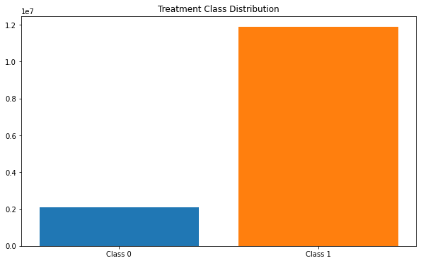
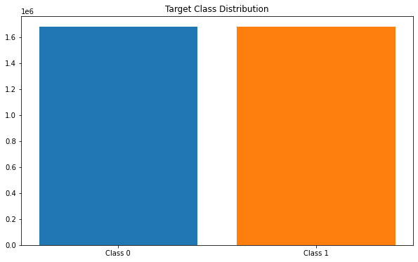
Before Resampling
Treatmnet Class
After Resampling
Target Class
Resampling the training data in which both treatment group and target group have balanced distribution

Slide 26


UpliftModeling - The Edge:
RESPONDENTS R
Target class : Treatment, Visit (Dropping Conversion , Exposure)
T indicated
treatment group
NON
RESPONDENTS N
𝑈𝑝𝑙𝑖𝑓𝑡 score = P(TR)/P(T) + P(CN)/P(C) - P(TN)/P(T) - P(CR)/P(C)
C indicated
Control group

Slide 27
The End Goal: and References
Our mission is clear - to elevate conversion rates by effectively identifying and engaging users who are on the cusp of purchasing. We're not just aiming for clicks; we're aiming for meaningful engagements that lead to sales.
This story provides a clear overview of your project's objectives, data-centric approach, and the sophisticated modeling techniques employed, all aimed at enhancing the effectiveness of digital advertising campaigns.
References:
Provost,F and Fawcett, Tom. (2013). Data science-what you need to know about analytic-thinking and decision-making. USA: O'RELLY.
*Kane, K., Lo, V. S., und Zheng. J., 2014. Mining for the Truly Responsive Customers and Prospects Using True-Lift Modeling: Comparison of New and Existing Methods. Journal of Marketing Analytics, 82(4), pp. 218-238.
*AMBIATA,"How uplift modeling works", https://ambiata.com/blog/2020-07-07-uplift-modeling/,

Slide 28

Thank you!
Want to invest??

